Slide 1
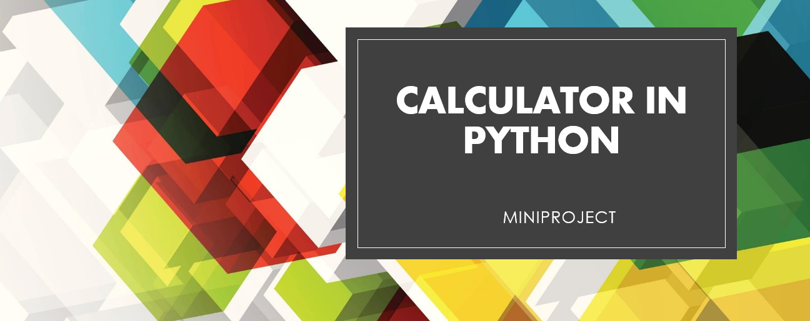
Presented by:
VALLARI KULKARNI - 16010320034
SAMIK LALWANI - 16010320038
ATHARVA KOTKAR - 16010320033

Slide 2
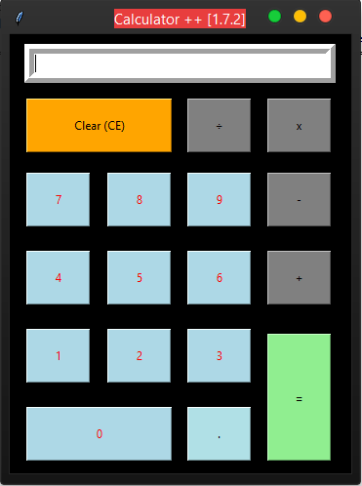
INTRODUCTION:
A Calculator is a device or software capable of performing mathematical calculations, such as addition, multiplication, subtraction, or division i.e a device that performs arithmetic operations on numbers.
In this program we will see how to accomplish the basic calculator functionalities using a python program. Here we create individual functions to carry out the calculations and return the result. Also user input is accepted along with the choice of operator.

Slide 3
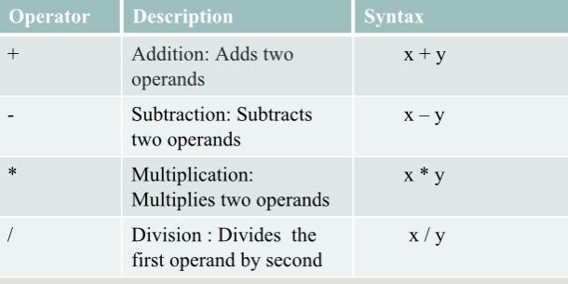
System Architecture:
Steps:
1/ User chooses the desired operations.
2/ Using comparison operator to check choice of user.
3/ Numbers are taken from the user and using function call to perform arithmetic operations.
4/ Using Arithmetic operators ‘+’ , ‘-’ , ‘*’ , ‘/’ , ‘pow’ , ‘sqrt’ to calculate the answer.
5/ While loop is used to initiate an infinite loop, it exits if user chooses ‘e’ as choice.
Operators used:

Slide 4
Concepts used:
1/ Defining functions
2/ Function call
3/ Type casting
4/ Exception handling
5/ Lambda operator
6/ Map operator
7/ Loops
Problem Statement:
Write a program to create a calculator which can perform arithmetic operations like addition, subtraction, multiplication, division etc, depending upon input from the user. Create lists, functions, conditions and loops to execute the program.

Slide 5
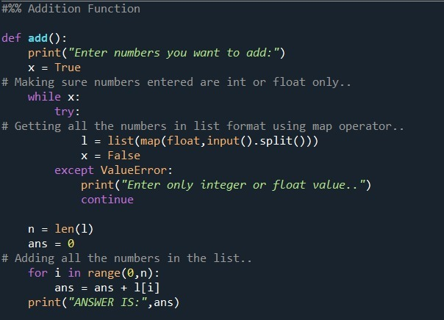
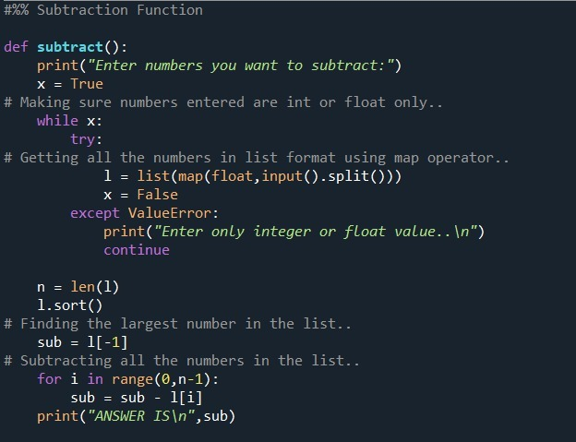
CODE & RESULT :

Slide 6
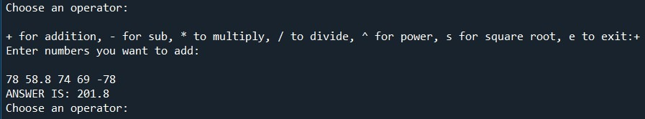
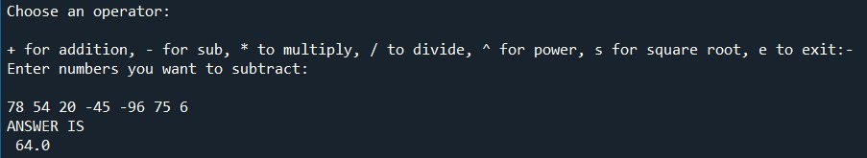
1. ADDITION
2. SUBTRACTION

Slide 7
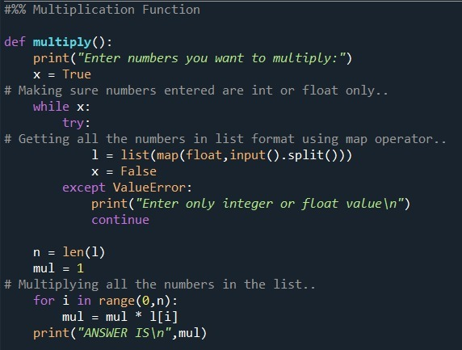
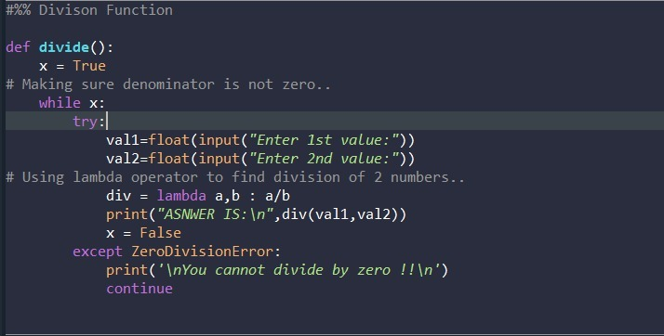

Slide 8
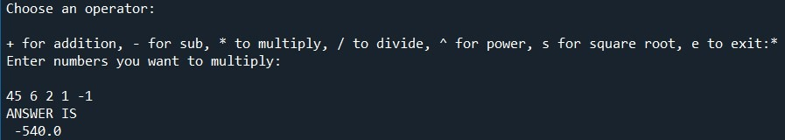
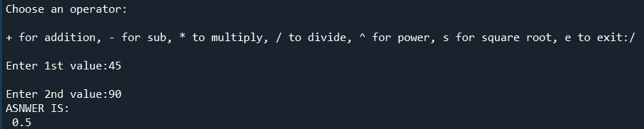
3. MULTIPLICATION
4. DIVISION

Slide 9
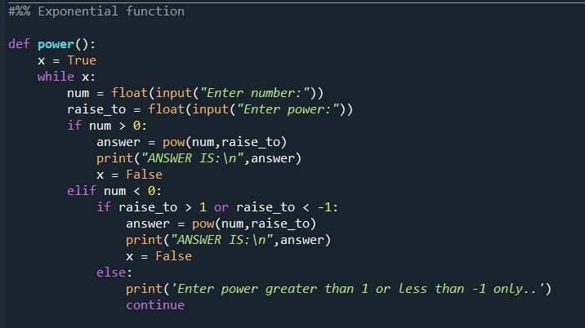
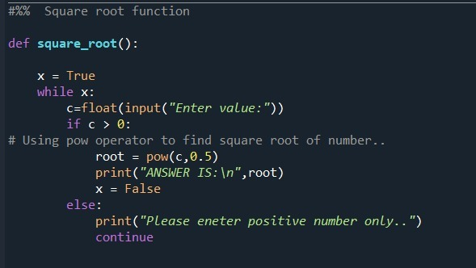

Slide 10
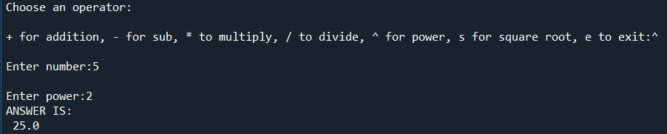
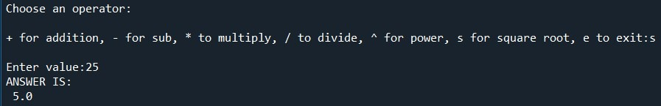
5. EXPONENTIAL FUNCTION
6. SQUARE ROOT

Slide 11
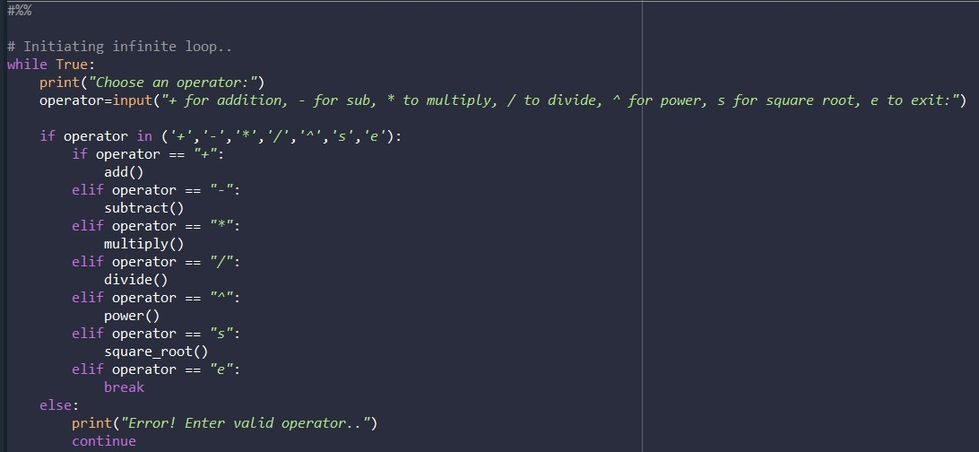

Slide 12
CONCLUSION:
We have successfully written the code for a simple calculator using various concepts such as; defining functions, function calls, exception handling, map operator, etc. We have successfully got an output for the program as shown above.
REFERENCES:
https://www.computerhope.com/jargon/c/calc.htm
https://stackoverflow.com/questions/31280385/tkinter-calculator-python-3-4-2

Slide 13
THANK YOU

